Slide 1
Testbed #3
3) Closed-loop Brain-controlled Interfaces: The center is focused on developing brain-controlled interfaces that assist individuals with movement impairments. Examples include remote assistive devices controlled by brain signals, and closed-loop systems were sensory information or motor intent is routed back into the nervous system via stimulation. Proposals that advance our ability to reliably record signals originating from the brain, extract useful control commands in real-time, and actuate an external device or deliver functional stimulation to the sensorimotor system are encouraged.

Slide 2
Closed-loop Brain-controlled Interfaces Block Diagram (overall)
E: Sensory Feedback - Motor intent is routed back into the nervous system via stimulation
A: Central Neural Interface - Record (wirelessly) signals originating from the brain
C: Robust Control of Remote System - Actuate remote assistive devices
B: Brain Neural Signal Translation - Extract useful control commands in real-time
D: Functional Electrical Stimulator - Deliver functional stimulation

Slide 3
System Specs for BCI Test-Bed
Phase | System Specs |  |  |  |  |  |  |  | Outcomes Goals
 | Power | Surface Area | Weight | CMOS Technology | Wireless Technology | Electrodes | Data Transmission Tech. | Distance
Phase 1 | 0.5 mW – 1mW (5V, mA) |  |  | MOSIS IBM – 45 nm to 0.25 µm TSMC - 40 nm to 0.35 µm |  | Thin-film (ECoG) 5x5 array | IR, Optical | 5m – 10m
Phase 2 | 100 uW 1V, mA |  |  | 22 nm |  | Thin-film (ECoG) 10x10 array | Optical | 30m – 50m
 | Energy Harvesting
Phase 3 | <100 uW (ultra low-power) Energy Harvesting |  |  | 22 nm or less | WBN | Deep electrodes (3D) with multi-sites (10x10 array) |  | > 50m

Slide 4
System Definitions for BCI Test-Bed
Push |  | Test Bed | Pull
Basic Science | Details |  | Technology Need | Details
Electrodes & Other Neural Interfaces |  | BCI Test Bed (2) | Implantable ECoG
Communications & Interfaces | Signal Processing |  | Implantable FES
 | Pre-Processing (Pre-amp, filters, etc)
 | Compression/Multiplexing |  | Wearable EEG
 | Power
 | Neural Signal Translation |  | Flexible Electronics
 | High-Level Intent Extraction
Movement Control Theory | Algorithms
 | BioMechanical Control
Movement Stimulation
Sensory Feedback | Visual Feedback
 | Tactile Feedback
 | Other Feedback mechanism(s)
Brain Adaptation | Neural Feedback Adaptation Strategy

Slide 5


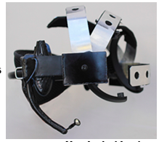
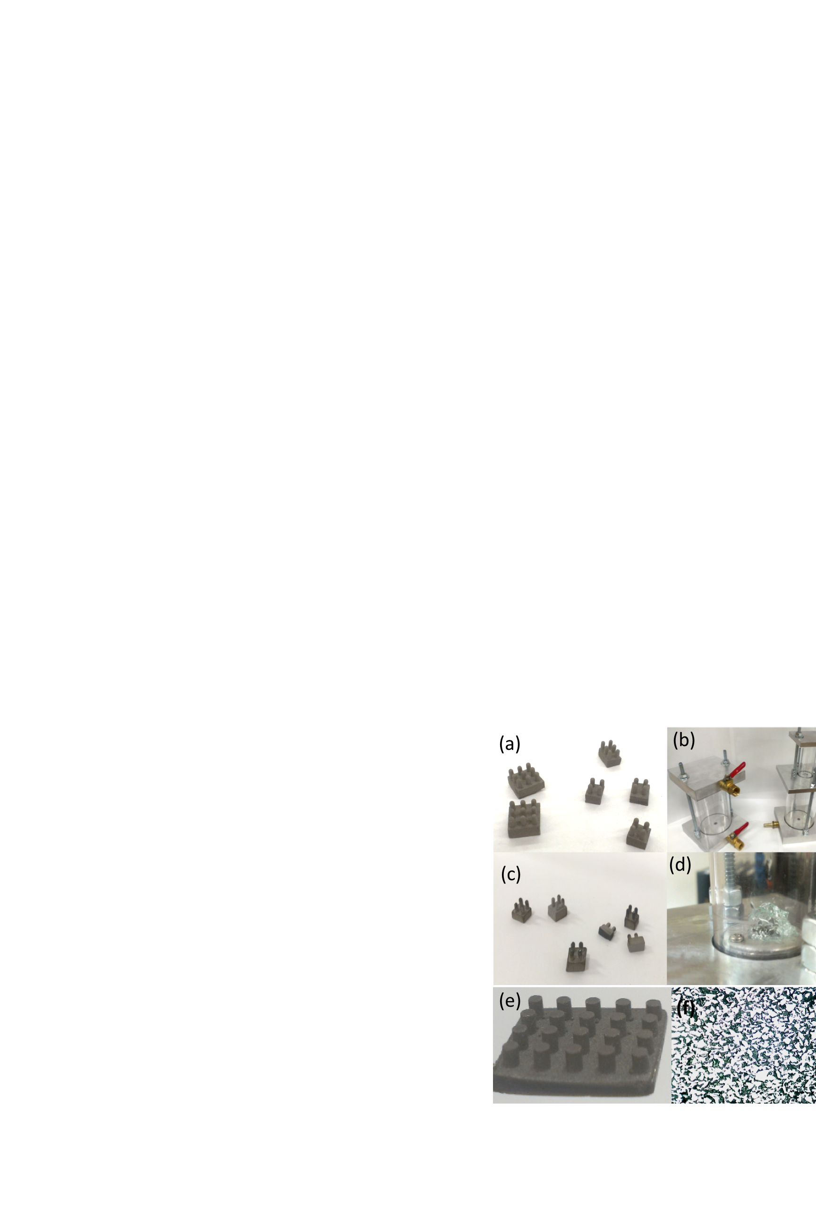
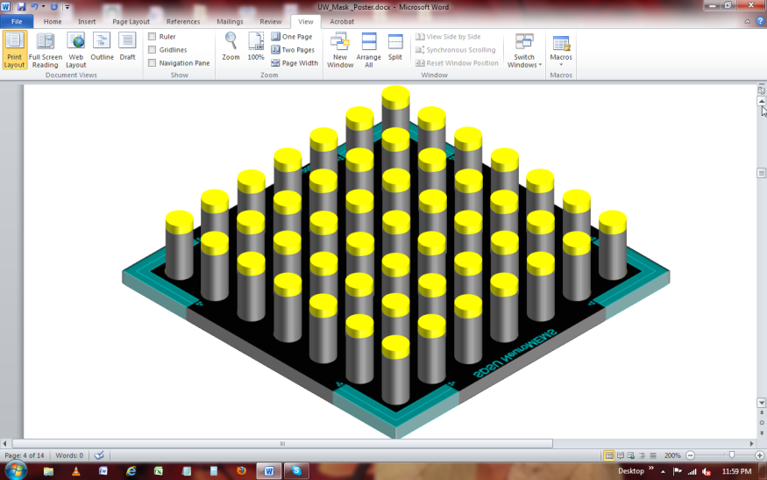
Center for Sensorimotor Neural Engineering
BCI- SDSU
SDSU Mobile EEG
3D gel-impregnated EEG electrode
Artifact removal algorithm
High-aspect ratio E-COG electrode

